Slide 1
Green Computing
Made by :
Keravi Dagha
FYIT-67

Slide 2
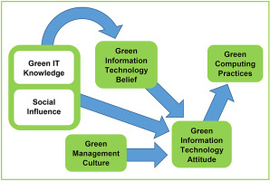

Slide 3
WHY GREEN COMPUTING.
Computer energy is often wasteful.
E.g.: Leaving the computer ON when not in use.
Printing is wasteful
E.g.: Email/meeting agenda’s print –out is a waste
Pollution
E.g.: Due to manufacturing, packaging, disposal techniques.
Toxicity.
E.g.: Due to toxic chemicals involved in manufacturing

Slide 4
ADVANTAGES OF GREEN COMPUTING.
Energy saving
Environmentally friendly
Cost-efficient (pays over time)
Save more money per year
Can give you a tax right off

Slide 5
NEED OF GREEN COMPUTING
To promote green computing concepts at all possible levels, the following four approaches are employed:
Green use: Minimizing the electricity consumption of computers and their peripheral devices and using them in an eco-friendly manner
Green disposal: Repurposing existing equipment or appropriately disposing of, or recycling, unwanted electronic equipment
Green manufacturing: Minimizing waste during the manufacturing of computers and other subsystems to reduce the environmental impact of these activities

Slide 6

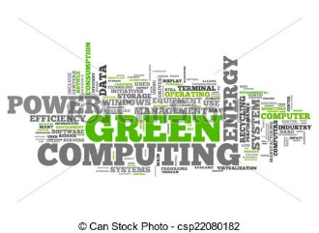
T
H
A
N
K
Y
O
U

Slide 7
THANK YOU

